Slide 1

Determinants

Slide 2
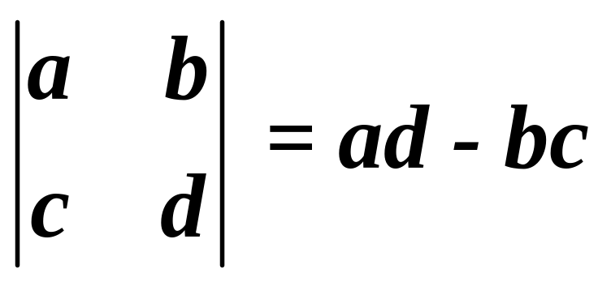
Determinant - a square array of numbers or variables enclosed between parallel vertical bars.
**To find a determinant you must have a SQUARE MATRIX!!**
Finding a 2 x 2 determinant:

Slide 3
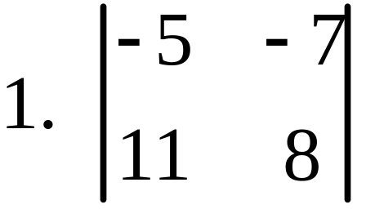
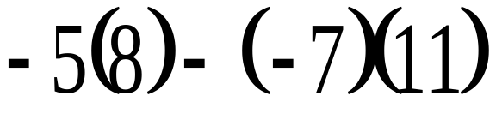
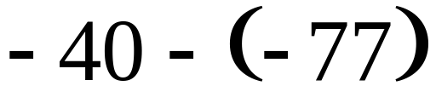

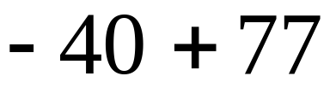
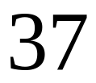
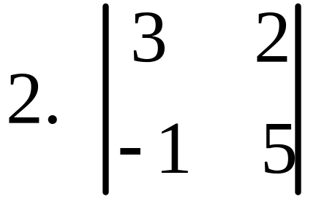
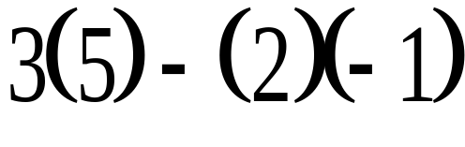
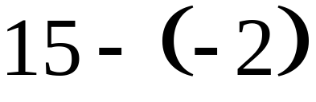
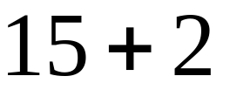

Find the determinant:

Slide 4
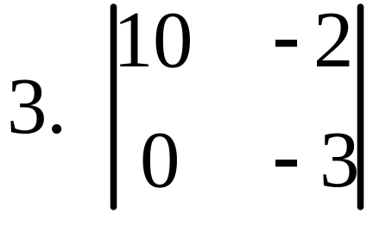
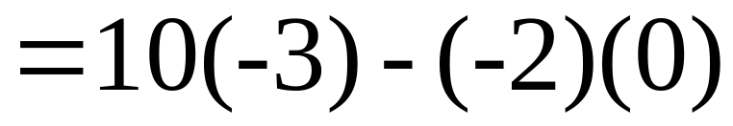
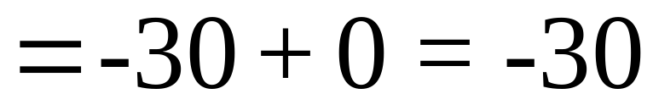
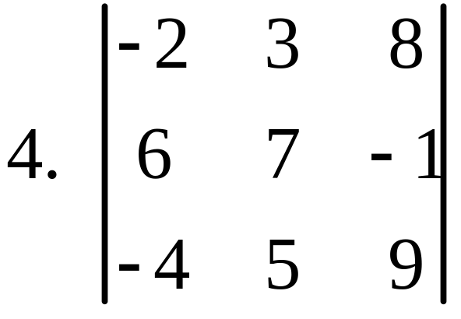
Finding a 3x3 determinant: Diagonal method
Step 1: Rewrite first two rows of the matrix.

Slide 5
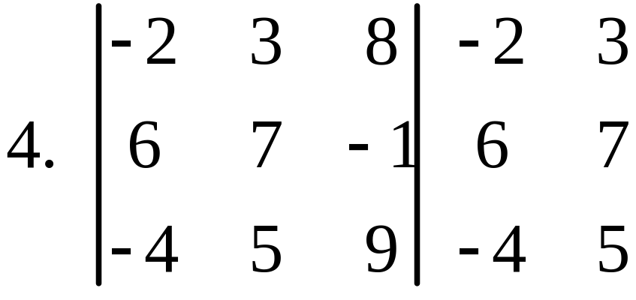
-224
+10
+162
= -52
Step 2: multiply diagonals going up!
Step 2: multiply diagonals going down!
-126
+12
+240
=126
Step 3: Bottom minus top!
126 - (-52)
126 + 52
= 178

Slide 6
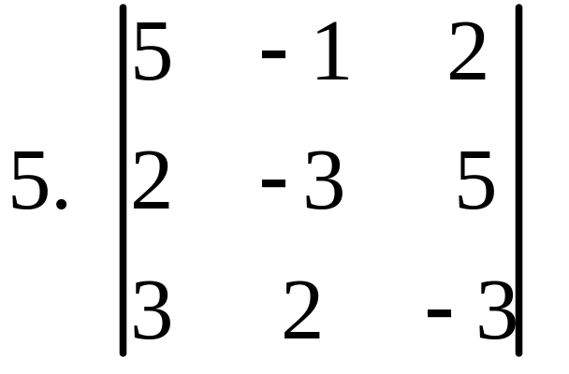
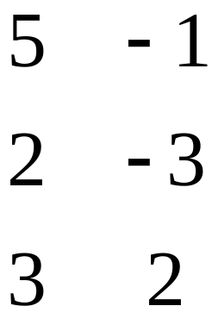
-18
+50
+6
= 38
Step 2: multiply diagonals going up!
Step 2: multiply diagonals going down!
45
- 15
+ 8
= 38
Step 3: Bottom minus top!
38 - 38
= 0

